Slide 1
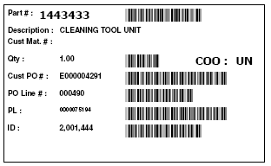
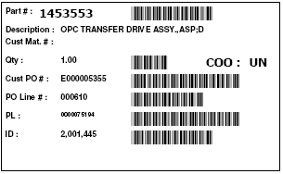
IT Module
WMS has to ensure that both of the Parts ID scanned cannot be the same number
WMS will then have to match & verify that these 2 Parts ID belongs to the same pallet
Part ID 1
2001444
Part ID 2
2001445
Wave Key
0000001
Pallet ID
2
PRINT
This print icon will only be available once the IDs are matched and pallet/wave ID confirmed
The print out must be in A4 size

Slide 2
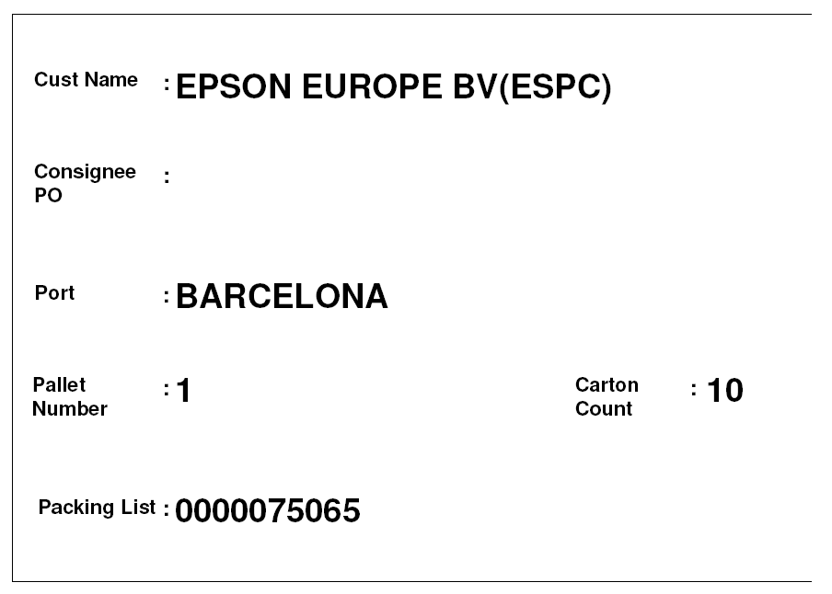
MOT: AIR

